Slide 1
讓我們帶著 SSIS 上雲端吧
傅士哲

Slide 2




自我介紹
SQL Server
2013~
五餅二魚工作室
www.dotblogs.com.tw/JamesFu
台中、新竹、台北
技術分享

Slide 3



Study4.TW
FB聊天社團
Study4.TW
FB粉絲專頁

Slide 4

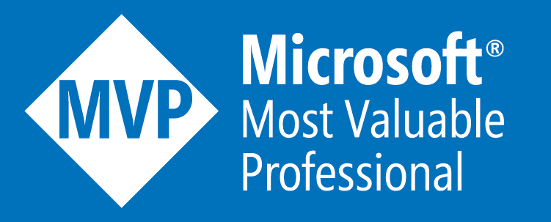





特別感謝

Slide 5
在 Azure 上使用 SSIS
類型 | OS | 功能 | 價格
SQL Server VM | Windows | Full | 略高
SSIS on Linux | Linux | 部分元件不支援 連線改用 ODBC | 較為低廉
ADF v2 IR |  | 限制較多 支援資料庫有限 | 費用需注意

Slide 6
SSIS
資料轉換與整合的工具
屬於 SQL Server 安裝項目之一
前身是 DTS ，SQL Server 2005 後改變為 SSIS
持續不斷的強化效能與功能

Slide 7

DTS
SSIS
SSIS Catalog
Project Deployment Model
AutoAdjustBufferSize
Control Flow Parts
Incremental Package Deployment
Notes:
https://docs.microsoft.com/zh-tw/sql/integration-services/data-flow/data-flow-performance-features
https://docs.microsoft.com/zh-tw/sql/integration-services/reuse-control-flow-across-packages-by-using-control-flow-package-parts

Slide 8



SSIS 的轉變

Slide 9
Demo: 專案部屬模式

Slide 10
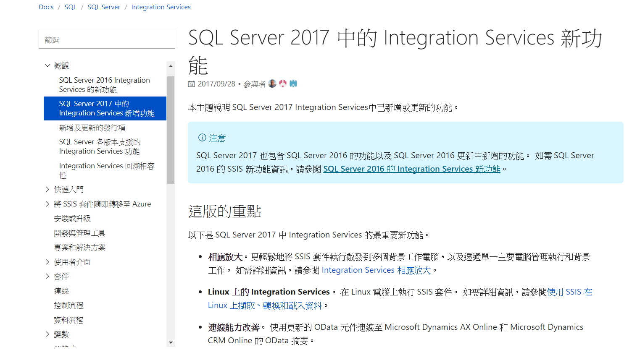
Notes:
https://www.mssqltips.com/sqlservertip/4943/execute-ssis-package-in-scale-out-mode--sql-server-2017/

Slide 11
Azure Feature Pack for SSIS
Connection Managers
Azure Storage Connection Manager
Azure Subscription Connection Manager
Tasks
Azure Blob Upload Task
Azure Blob Download Task
Azure HDInsight Hive Task
Azure HDInsight Pig Task
Azure HDInsight Create Cluster Task
Azure HDInsight Delete Cluster Task
Data Flow Components
Azure Blob Source
Azure Blob Destination
Azure Blob Enumerator
Foreach Azure Blob Enumerator

Slide 12
Install SSIS on Centos
curl https://packages.microsoft.com/config/rhel/7/prod.repo > /etc/yum.repos.d/msprod.repo
curl https://packages.microsoft.com/config/rhel/7/mssql-server-2017.repo > /etc/yum.repos.d/mssql-server.repo
yum install mssql-tools unixODBC-devel -y
yum install -y mssql-server-is
/opt/ssis/bin/ssis-conf setup

Slide 13
Pricing : SSIS
Basic SSIS for Free (Import and Export Wizard)
Express
Standard SSIS features
Standard and BI Edition
Advanced SSIS features
CDC and advanced adapters
Enterprise Edition

Slide 14
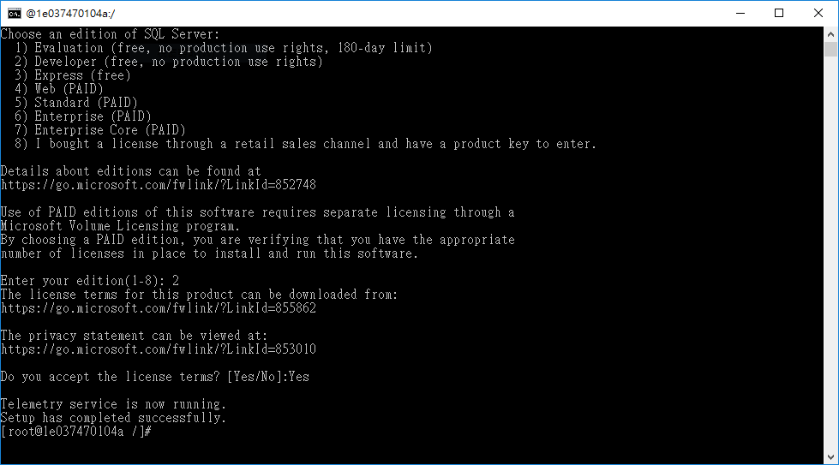
SSIS on Linux

Slide 15
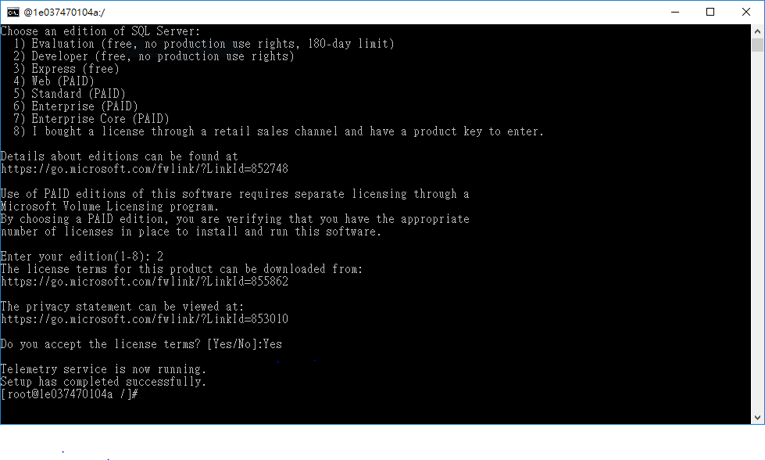

Slide 16
Demo: SSIS 2017

Slide 17
What is Azure Data Factory
Azure Data Factory is a cloud-based data integration service that automates moving and transforming data.
Compose data processing, storage, and movement services to create and manage analytics pipelines
Rich, simple end-to-end pipeline monitoring and management
Initially focused on Azure and hybrid movement to/from on premises SQL Server.
Notes:
Initially focused on Azure and hybrid movement to/from on premises SQL Server. – This is the space the SSIS is not strong in… getting data to/from the cloud.

Slide 18
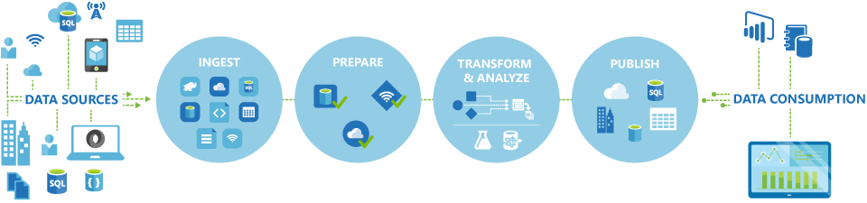
What is Azure Data Factory
A managed cloud service for building & operating data pipelines
Part of the Cortana Analytics Suite

Slide 19







Cortana Analytics Suite Transform data into intelligent action
Information Management
Big Data Stores
Machine Learning and Analytics
Dashboards and Visualizations
Business apps
Power BI
Azure
Data Factory
Azure
Machine Learning
Azure
Data Factory
Personal Digital Assistant
Azure
Data Lake store
Cortana
Azure Data Lake analytics service
People
Custom apps
Azure
Data Catalog
Perceptual Intelligence
Azure HDInsight
(Hadoop and Spark)
Face, vision
Azure
SQL Data Warehouse
Speech, text
Azure
Event Hub
Azure
Stream Analytics
Business Scenarios
Sensors and devices
Recommendations,
customer churn,
forecasting, etc.
Automated Systems
DATA
INTELLIGENCE
ACTION
Notes:
Cortana Analytics Suite delivers an end-to-end platform with integrated and comprehensive set of tools and services to help you build intelligent applications that let you easily take advantage of Advanced Analytics.
First Cortana Analytics Suite provides services to bring data in, so that you can analyze it. It provides information management capabilities like Azure Data Factory so that you can pull data from any source (relational DB like SQL or non-relational ones like your Hadoop cluster) in an automated and scheduled way, while performing the necessary data transforms (like setting certain data colums as dates vs. currency etc). Think ETL (Extract, Transform, Load) in the cloud. Event hub does the same for IoT type ingestion of data that streams in from lots of end points.
The data brought in then can be persisted in flexible big data storage services like Data Lake and Azure SQL DW.
You can then use a wide range of analytics services from Azure ML to Azure HDInsight to Azure Stream Analytics to analyze the data that are stored in the big data storage. This means you can create analytics services and models specific to your business need (say real time demand forecasting).
The resultant analytics services and models created by taking these steps can then be surfaced as interactive dashboards and visualizations via Power BI
These same analytics services and models created can also be integrated into various different UI (web apps or mobile apps or rich client apps) as well as via integrations with Cortana, so end users can naturally interact with them via speech etc., and so that end users can get proactively be notified by Cortana if the analytics model finds a new anomaly (unusual growth in certain product purchases- in the case of real time demand forecasting example given above) or whatever deserves the attention of the business users.

Slide 20
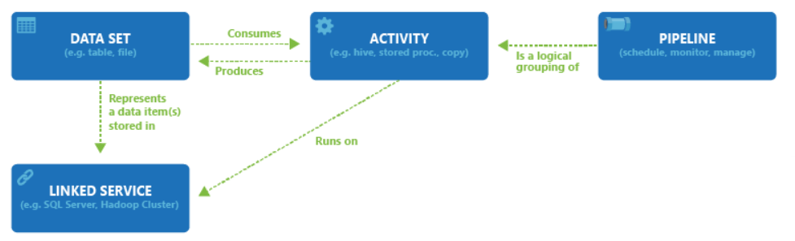
Azure Data Factory Artifact Overview

Slide 21
Linked Services
Linked services define the information needed for ADF to connect to external resources.
Linked services are used for two purposes:
To represent a data store including:
Azure Storage, Azure SQL, Azure SQL Data Warehouse, Azure DocumentDB
SQL Server, Oracle, File System, DB2, MySQL, Teradata, PostgreSQL, Sybase
To represent a compute resource that can host the execution of an Activity. For example, the “HDInsightHiveActivity” executes on an HDInsight Hadoop cluster.

Slide 22
Datasets
Datasets are named references to the input or output data of an Activity.
Datasets identify structures within different data stores including tables, files, folders, and documents.

Slide 23
Activities
Activities define the actions to perform on your data.
Each activity takes zero or more datasets as inputs and produces one or more datasets as outputs.
An activity is a unit of orchestration in Azure Data Factory.
Available Data Movement Activities
Copy
Available Transformation Activities | Compute environment
Hive | HDInsight [Hadoop]
Pig | HDInsight [Hadoop]
MapReduce | HDInsight [Hadoop]
Hadoop Streaming | HDInsight [Hadoop]
Machine Learning Batch Execution | Azure VM
Stored Procedure | Azure SQL
DotNet | HDInsight [Hadoop] or Azure Batch

Slide 24
Pipelines
Pipelines are a logical grouping of Activities.
They are used to group activities into a unit that together perform a task.
Activities grouped into a single Pipeline can be deployed, scheduled, or deleted as one single unit instead of managing each individual activity independently.

Slide 25
Data Management Gateway
The Data Management Gateway allows secure access to on-premises data sources
No corporate firewall changes (Gateway uses HTTP based connections)
Encrypt credentials for your on-premises data stores with your certificate
Parallel data transfer, resilient to network issues with auto retry logic.
Considerations:
A single gateway instance is tied to only one Azure Data Factory
Only one instance of Data Management Gateway can be installed on a single machine

Slide 26

SSIS v.s ADF

Slide 27
Azure Data Factory Version 2
Integration Runtime (IR)
Move data.
Execute ADF activities.
Execute SSIS packages.

Slide 28
Install
使用 PowerShell 安裝
Install-Module AzureRM.DataFactories
Set-AzureRmDataFactoryV2IntegrationRuntime
Start-AzureRmDataFactoryV2IntegrationRuntime
語法太長，時間有點久，請參考
https://dotblogs.com.tw/jamesfu/2017/12/11/ssisonazure
注意你的 Azure 額度 !!!

Slide 29
Demo: IR

Slide 30
在 Azure 上使用 SSIS
類型 | OS | 功能 | 價格
SQL Server VM | Windows | Full | 略高
SSIS on Linux | Linux | 部分元件不支援 連線改用 ODBC | 較為低廉
ADF v2 IR |  | 限制較多 支援資料庫有限 | 費用需注意

Slide 31


